Slide 1


LotBot
Reinventing the Lot
Notes:
How many of you have been trapped searching for parking? Once, I was stuck in the car watching as someone came up to our car and started yelling at my dad for “taking his spot”

Slide 2

Time Spent Searching for Parking per Trip
Seattle
8 mins
New York City
13 mins
San Francisco
11 mins
Chicago
9 mins
Boston
8 mins
Washington DC
9 mins
Los Angeles
11 mins
Atlanta
8 mins
Dallas
9 mins
Notes:
Across the country, people are spending inordinate amounts of time simply finding parking

Slide 3
The Issue with Parking Lots
hours/year
17
spent
finding parking
Notes:
Time adds up to over 17hrs/yr which can be spent working, spending time with family, or working on a startup project

Slide 4
The Issue with Parking Lots
61%
20%
39%
of all accidents occur in parking lots
of drivers avoided shopping destinations due to a lack of parking
of drivers reported feeling stressed trying to find parking
Notes:
Parking lots across the world have turned into stressful and dangerous areas. This has lead to drivers avoiding shopping destinations simply to avoid parking.

Slide 5
Millennials are savvy, price-conscious shoppers, yet they also tend to place a high value on experiences, perhaps more so than on the acquisition of material goods
Notes:
Further pushed by the stressed, and busy millennial who value their experiences far more than whatever they buy. Especially during the age of COVID as people turn to online shopping for their retail needs, how does in person shopping differentiate itself?

Slide 6
Our Solution
A website where users can reserve a parking space to keep parking lots clear and:
Save Time
Decrease Stress
Stay Organized
Notes:
That’s where we come in. LotBot is a website where users can reserve a parking space to keep parking lots clear. Our technology can be implemented into any lot to keep the traffic out of the parking lot

Slide 7
The Product

Slide 8
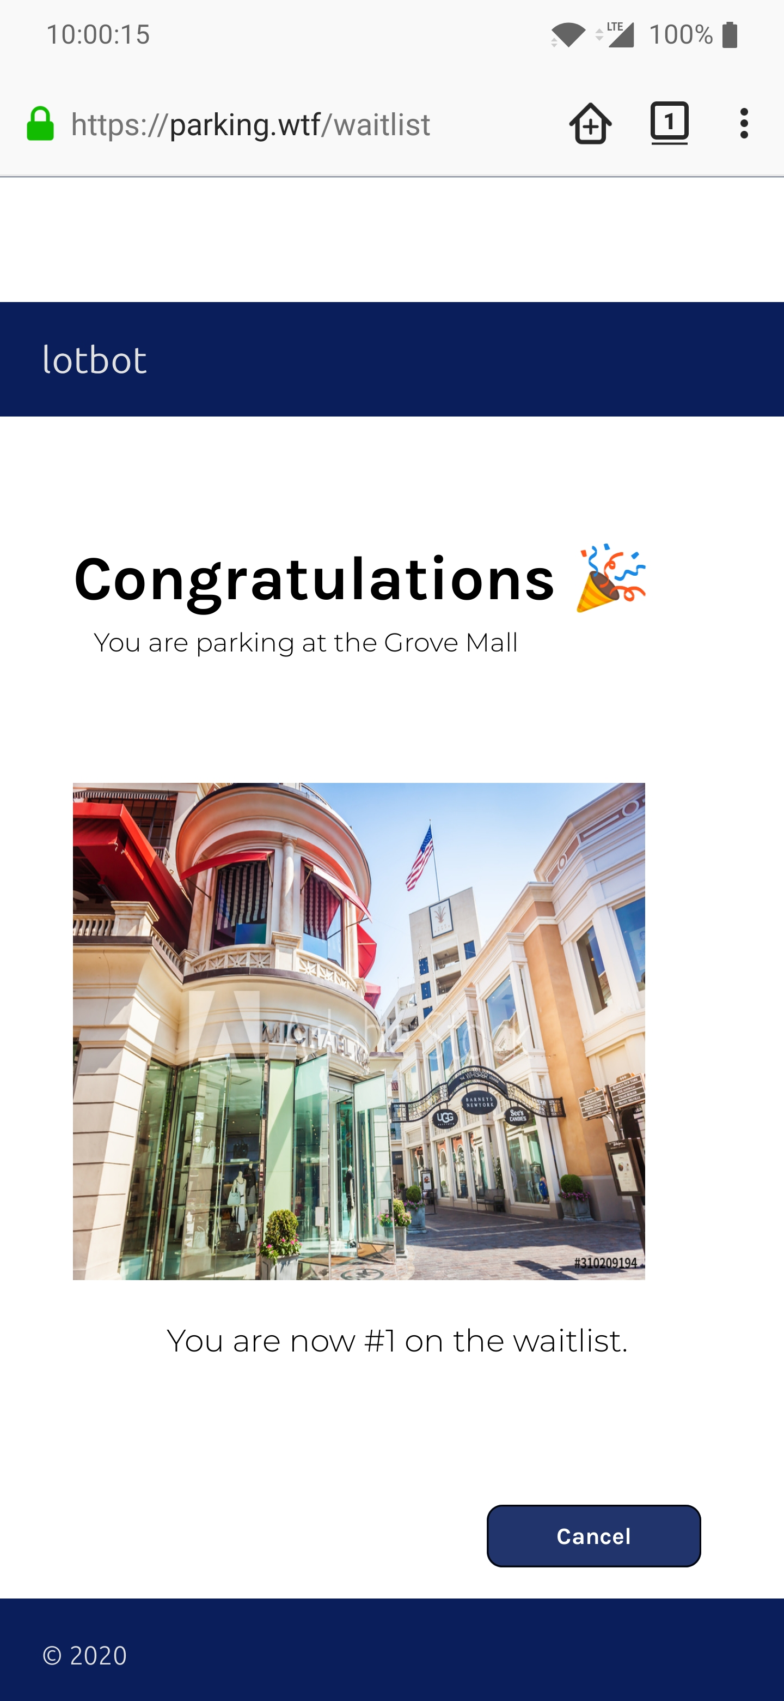
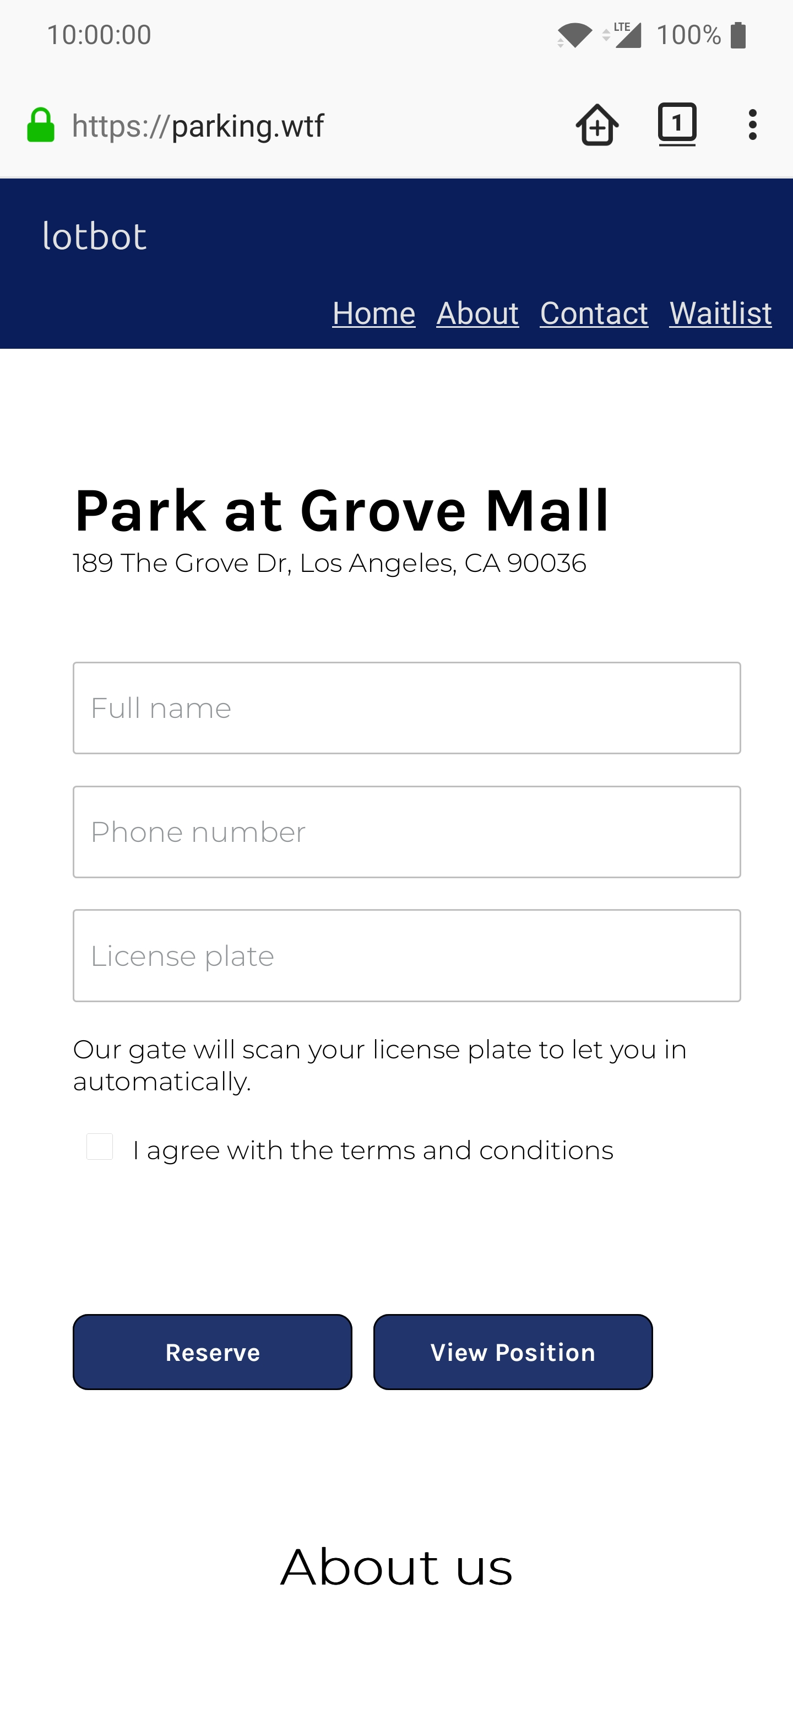
Software Demo
Using LotBot is as simple as:
Entering your license plate and phone number
(Optional) Pay online
Wait for our text
Drive up to the gate
Try it yourself at www.parking.wtf
Place your screenshot here
Notes:
Imagine this: example

Slide 9
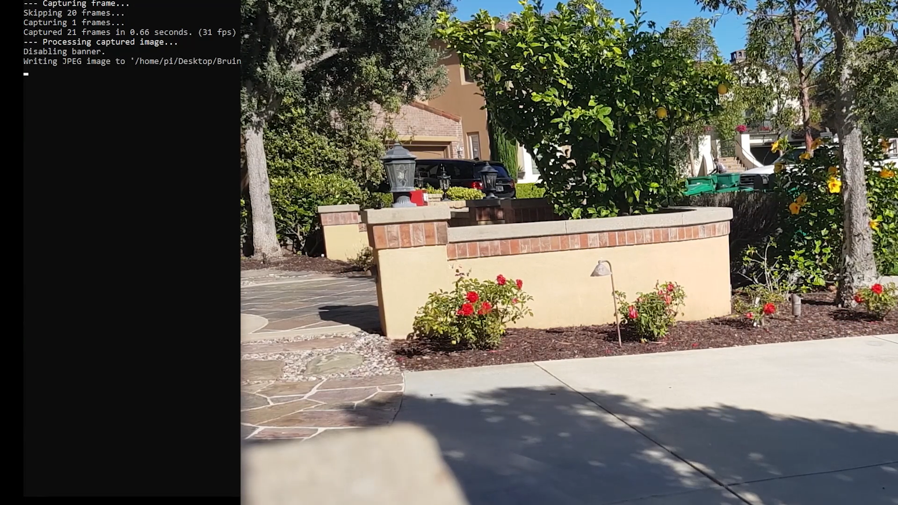
Hardware Demo
Notes:
Example cont

Slide 10
The Parking Manager’s Side
We send a LotBot box to you for a quick and easy installation
Select payment plan, number of spots, whitelists, and many other options
Monitor your lot’s data to customize your LotBot system to your own needs
Notes:
We want to put the power into the parking lot manager’s hands by making it entirely customizable

Slide 11
Market Validation
31+
$18,500,000
major malls have adopted MyPark’s smart parking system
Invested into smart parking systems in Los Angeles
Notes:
MyPark, another parking reservation system which uses a more complex system of sensors, has already been adopted into 31+ major malls across the country, serving an estimated 62 million customers a year.

Slide 12
Market Validation
Shopping centers rated importance of ease of access
4.45/5
Ranking in the
TOP 5
Most important factors in shopping center management
Notes:
Shopping centers across the country agree that ease of access is one of the most important factors in management, boosting sales and return visit rates

Slide 13
Market Size
3.9 B
Total Available Market
Global Smart Parking
2.7 B
Serviceable Available Market
Off Street Parking (68.45%)
Serviceable Obtainable Market
530 M
App Based (13.6%)
Notes:
Smart parking sphere is a huge industry set to continue growing
Off street parking takes a large portion of that
Off street commercial parking is set to only grow, as more and more lots adopt app based system to manage their lots

Slide 14
Business Plan
PAYMENT PLAN | ONE TIME INSTALLATION FEE | MONTHLY FEE
Small | $200 | $100
Medium | $200-$400 | $250
Large | $400+ | $450

Slide 15
Market Adoption
📌
🤝
🌳
EVENTS
SHOPPING PLAZAS
PUBLIC PARKS
target temporary events
smaller plazas
environmentally focused parks
626 Night Market
Orange County Fair
Hollywood Bowl
Westwood Village Square
Westwood Center
Ardent Fair Mall
Crystal Cove
Yosemite National Park
Laguna Beach

Slide 16
Competition
🔎
🙋
📝
Parking Finders
SpotHero
EasyPark
ParkWhiz
ParkiFi
ParkMe
Anagog
Intelligent Parking Assistance
Park Assist
Park Help
Streetline/Kapsch TrafficCom
Get My Parking
Reservation Systems
MyPark
Quercus
LotBot

Slide 17
Competitive Advantages
LOW OVERHEAD
EASE OF USE
REALTIME WAITLISTS
Our easy to install and centralized system avoids the need for complex arrays of cameras or sensors
Users avoid the hassle of downloading an app and signing up through the use of our simple web application
Realtime information on waitlists keeps users in the know as they await to enter the parking lot.
DATA ORIENTED
CUSTOMIZABLE
License plate recognition can be used to extrapolate data for use in business analysis
Parking lot managers can dictate everything from parking fees to reservation capacity to best fit their needs.
Notes:
LotBot stands out among other reservation style apps by completely focusing around the user experience. From putting the power into the lot manager’s hands, to a fast and easy website with no barriers of entries, our goal is to make parking as accessible as possible.

Slide 18





Our Team
HARDWARE DEV/MARKETING
PROJECT MANAGER
SOFTWARE DEV
WILLIAM HUANG
UCLA ’24
ELECTRICAL ENGINEERING
SUMAN SHARMA
UCLA ANDERSON ‘22
BUSINESS ADMINISTRATION
JACK LIU
BERKELEY ‘24
COMPUTER SCIENCE
SOFTWARE DEV
UI/UX DEV
SOLOMON LO
UCLA ’23
COMPUTER SCIENCE
MICHELLE HWANG
UCLA ‘20
COGNITIVE SCIENCE
Notes:
Our mixed age group makes us perfect to understand the upcoming generation of people and how they might be affected

Slide 19
What’s in Store
17.4%
That’s the projected global growth of Smart Parking in the next 7 years
LOS ANGELES
That’s our first market, with over 100 potential locations for LotBot
COVID-19
That’s what we want to help control by allowing shopping centers
to monitor the flow of people right as they come in
Notes:
After improving on our prototype and continuing testing

Slide 20
THANKS!
We would like to extend our thanks to the BruinLabs organizers and judges for giving us a platform to learn, grow, and develop our skills in entrepreneurship and tech!

